Slide 1
BTP
Classification of the eye in AM/PM
Supervisor
Prof. Pabitra Mitra
CSE Department
-- AKSHAT SUWALKA
4th year student
Mechanical Department

Slide 2
Raw Data

Slide 3
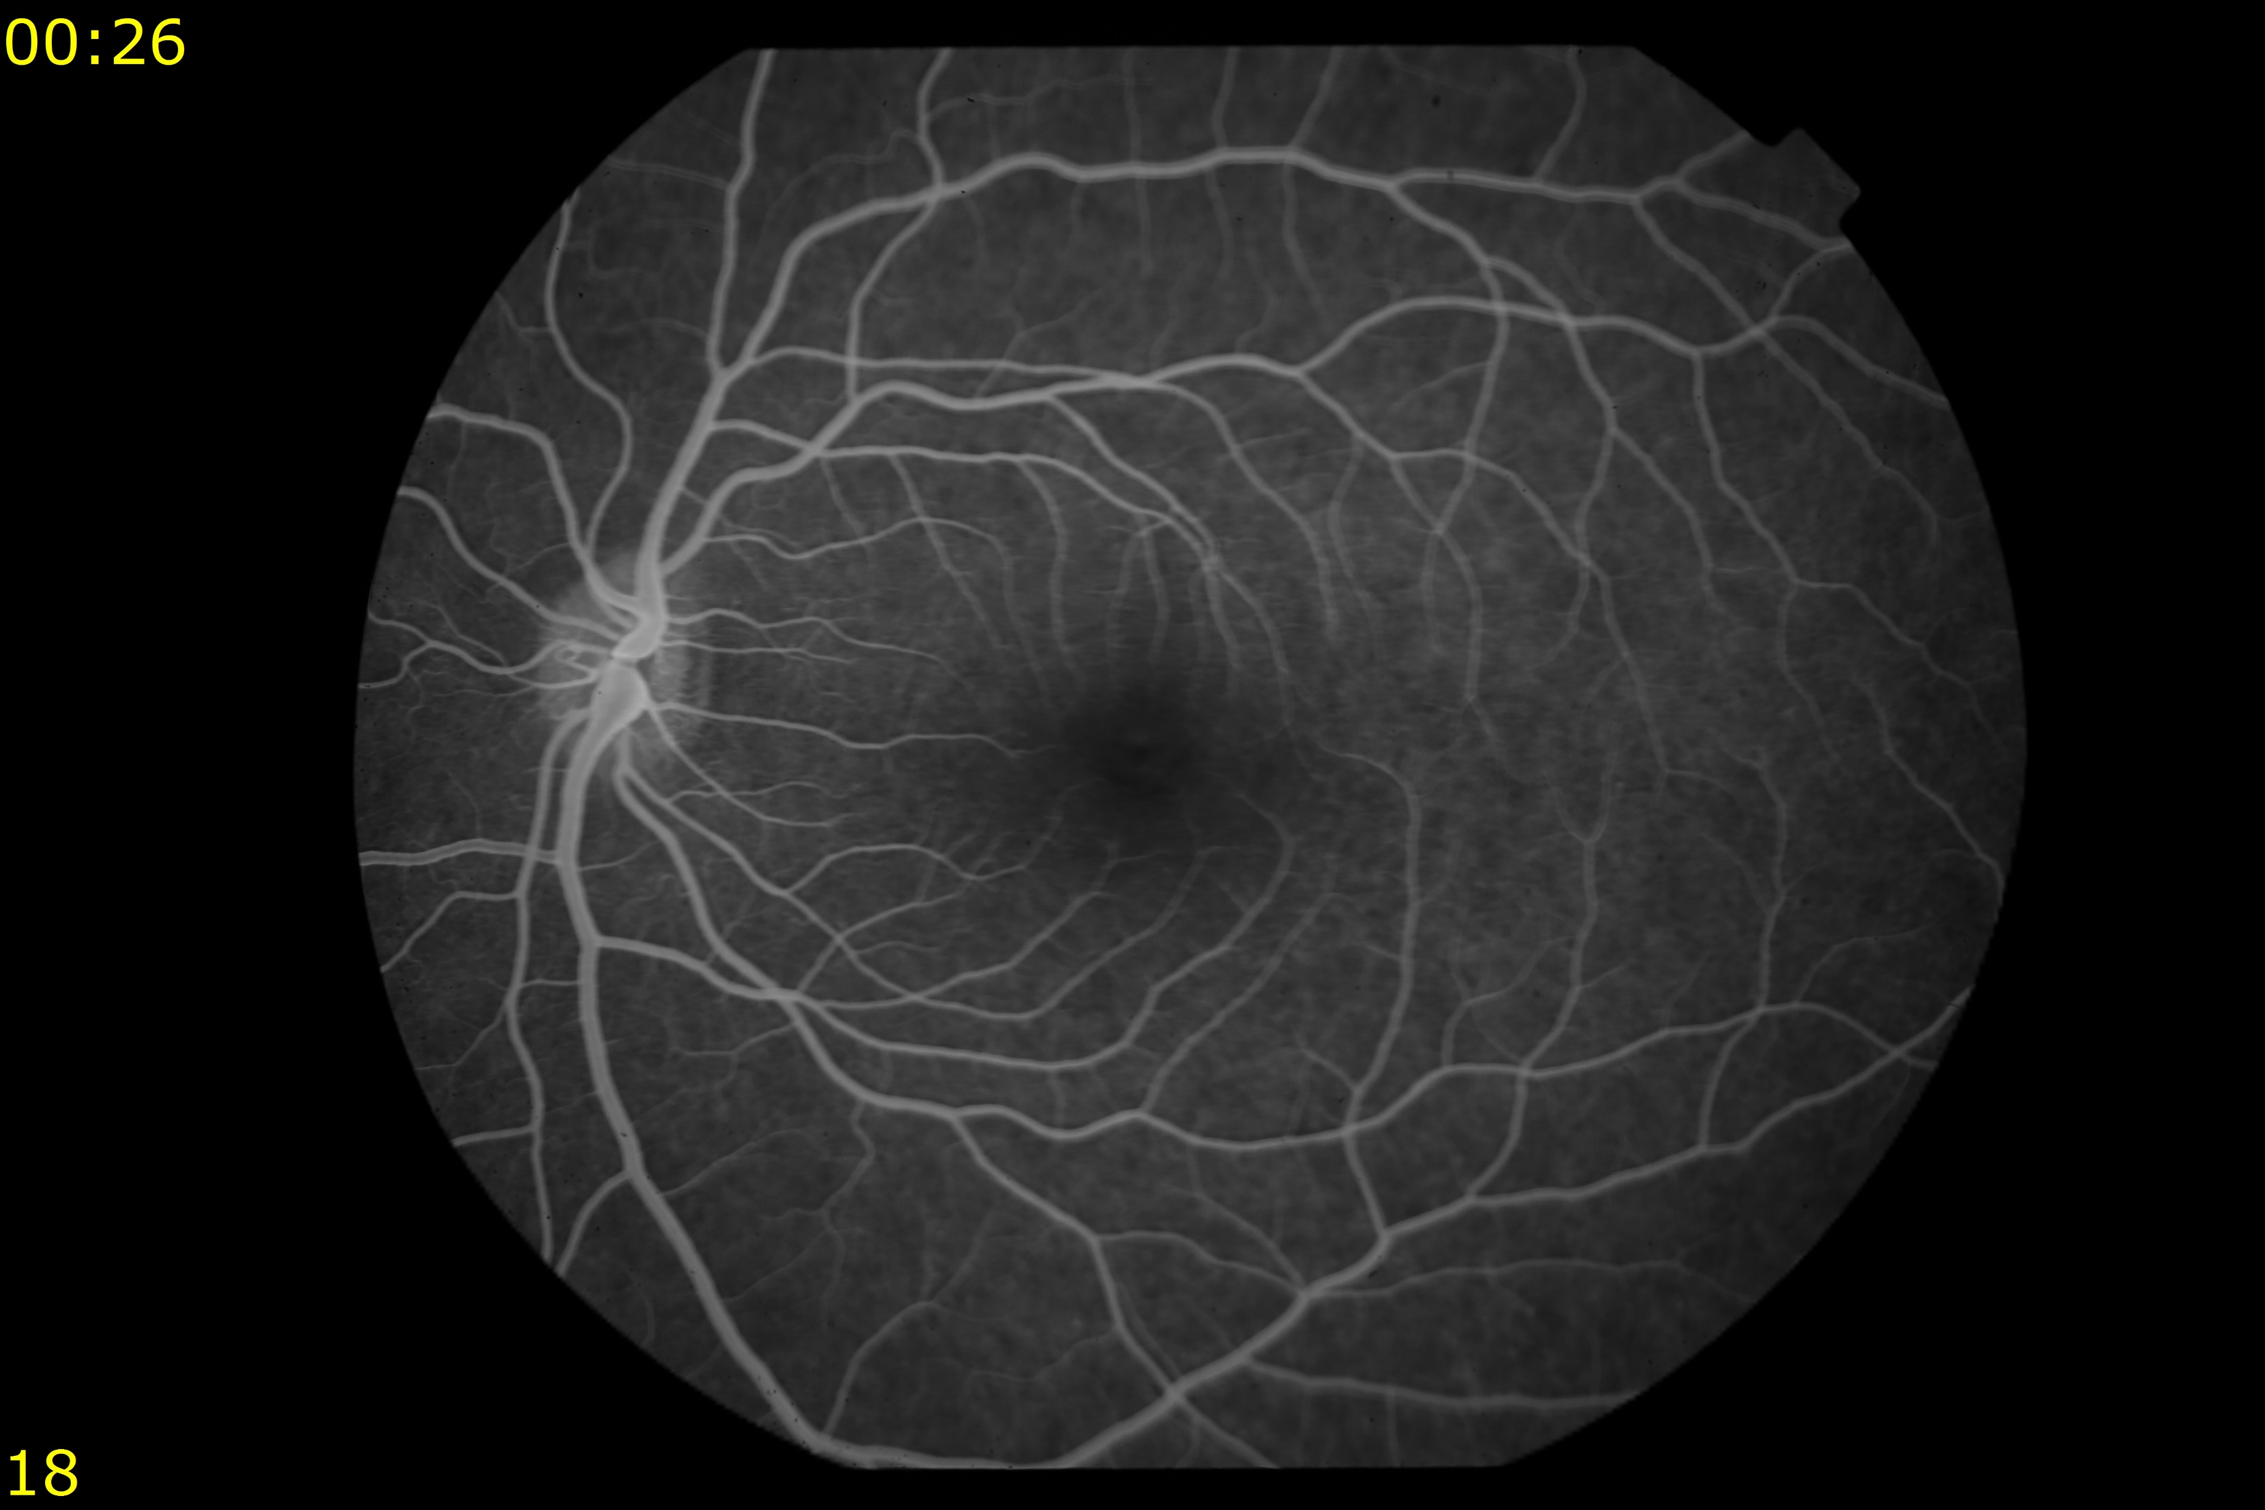

Slide 4
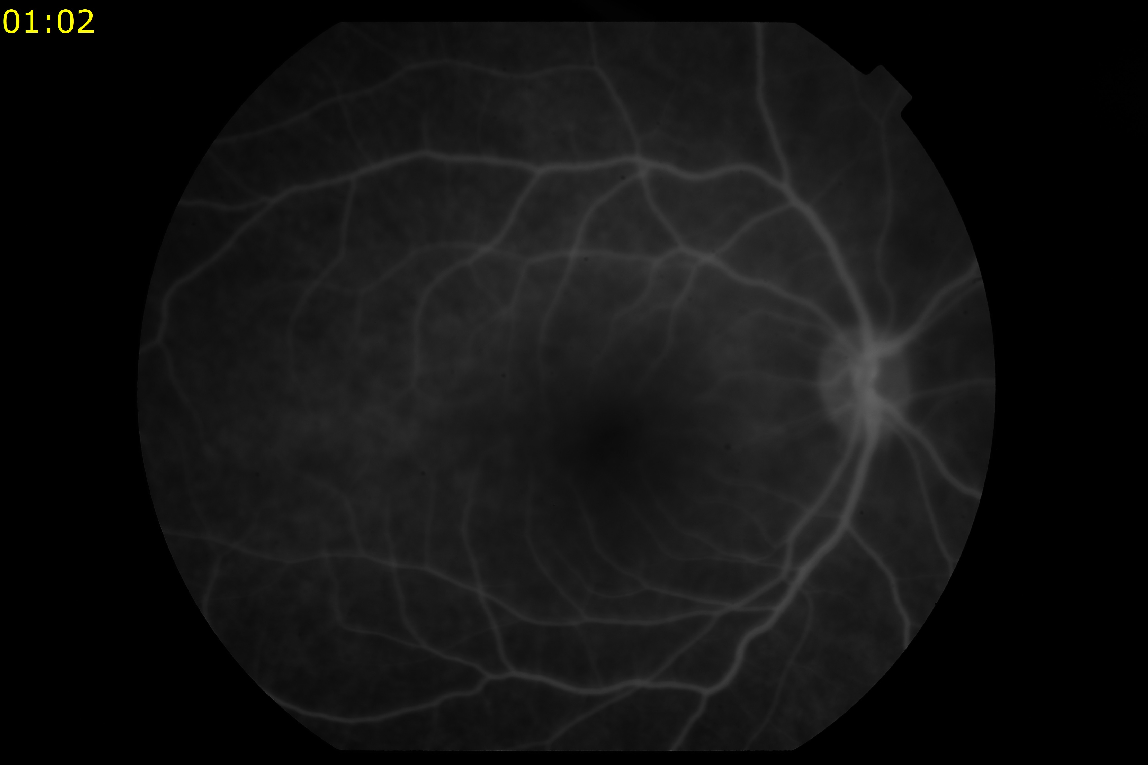

Slide 6
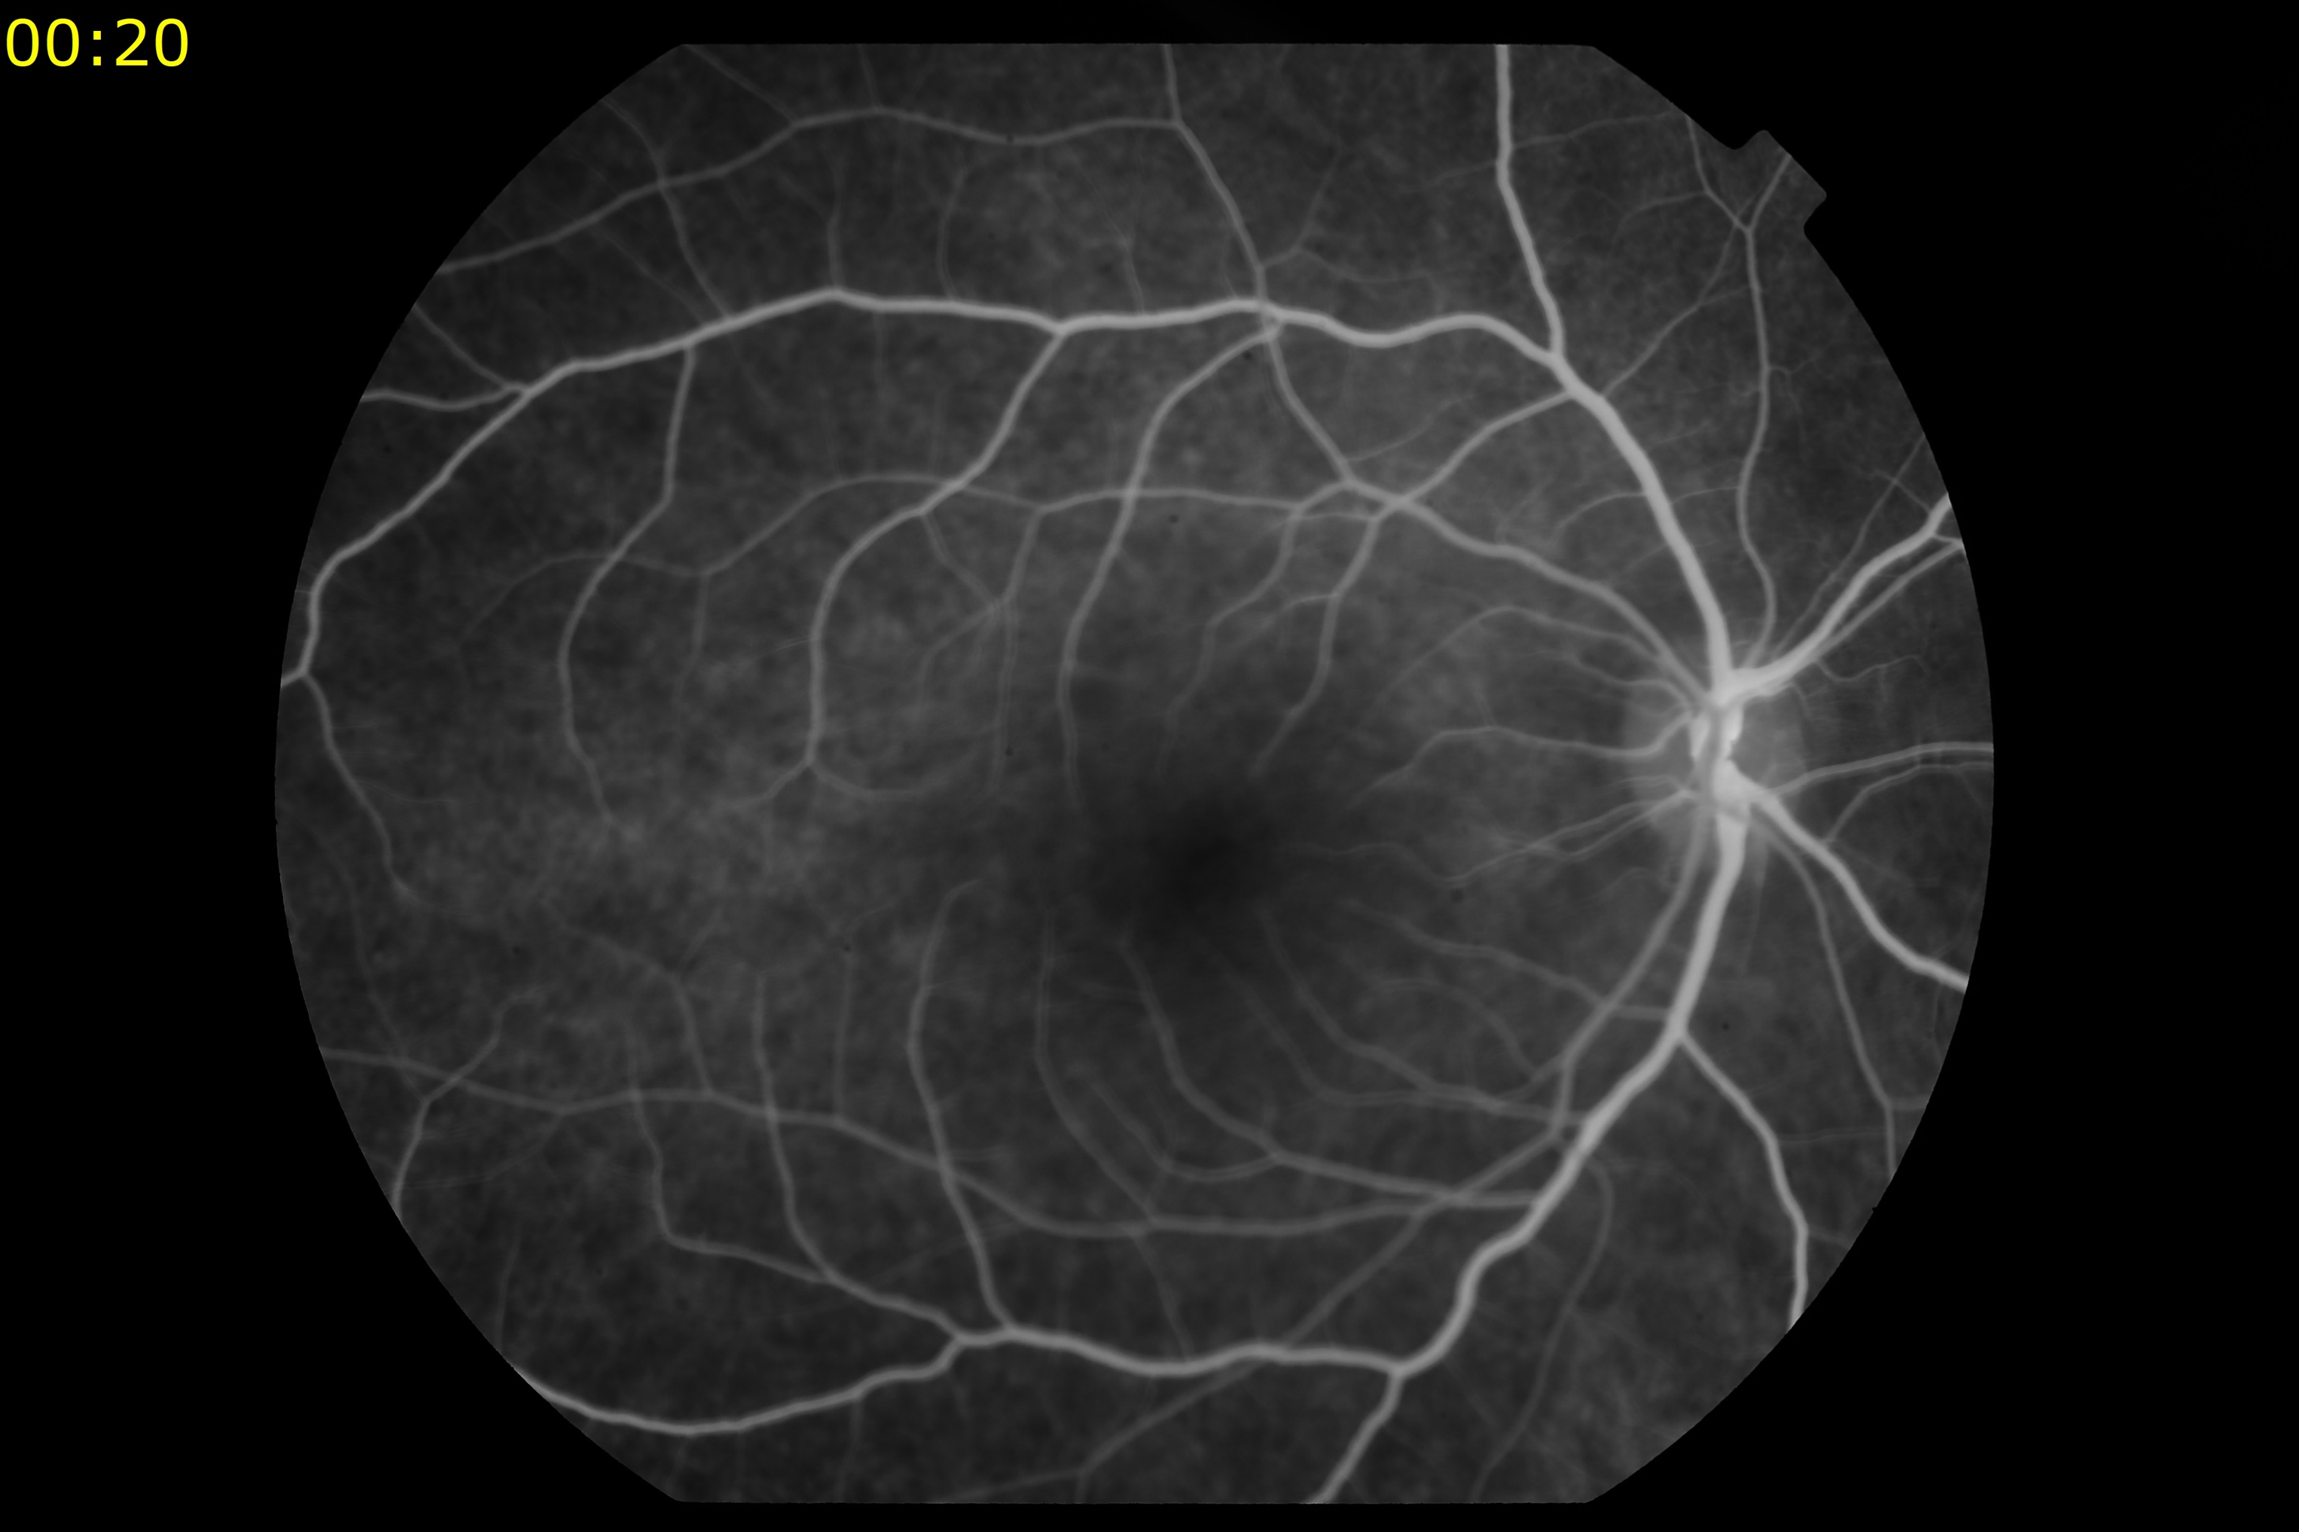

Slide 7
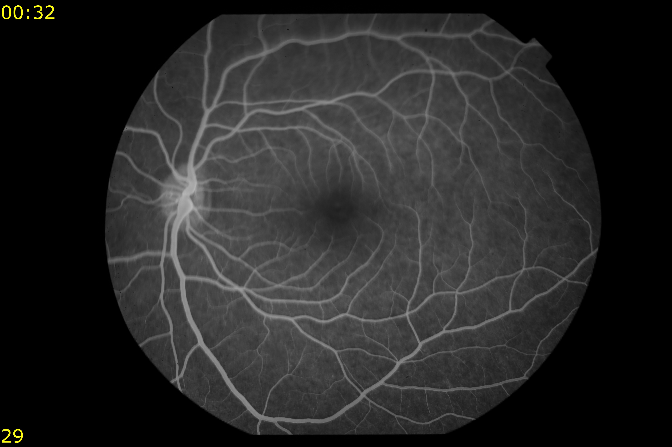

Slide 8
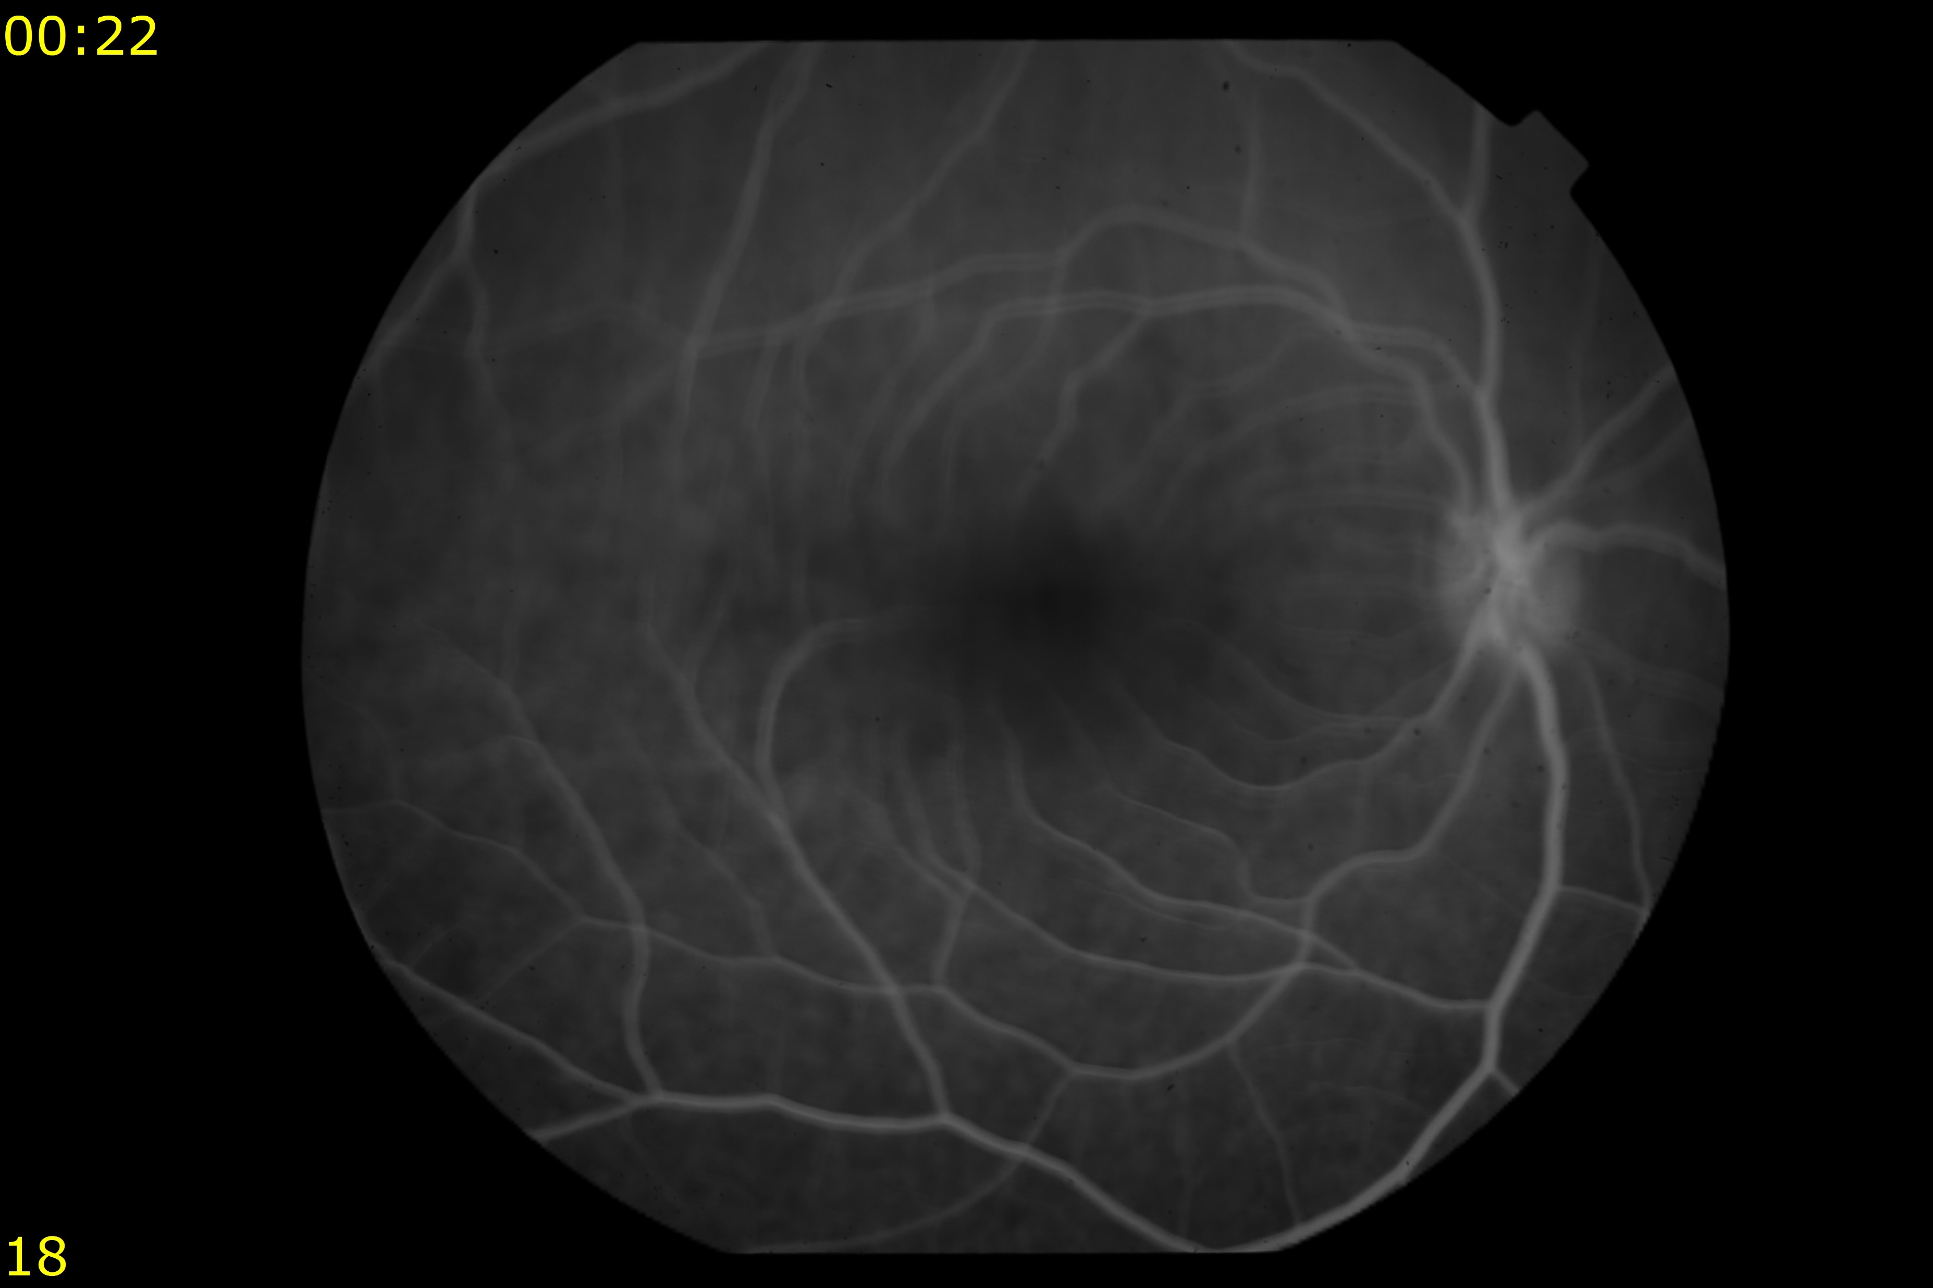

Slide 9
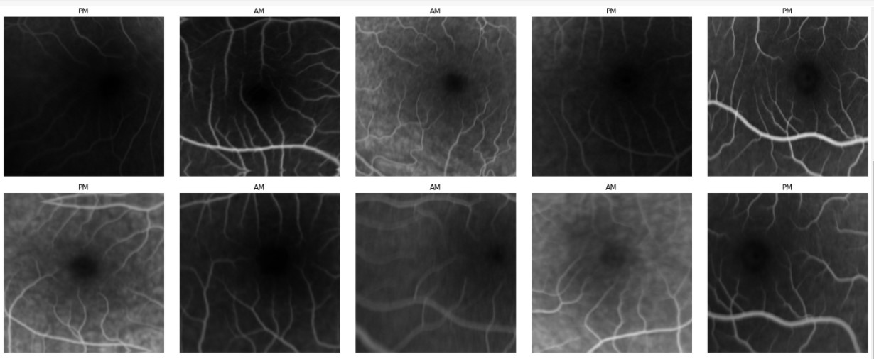
Data after extracting its useful part

Slide 10
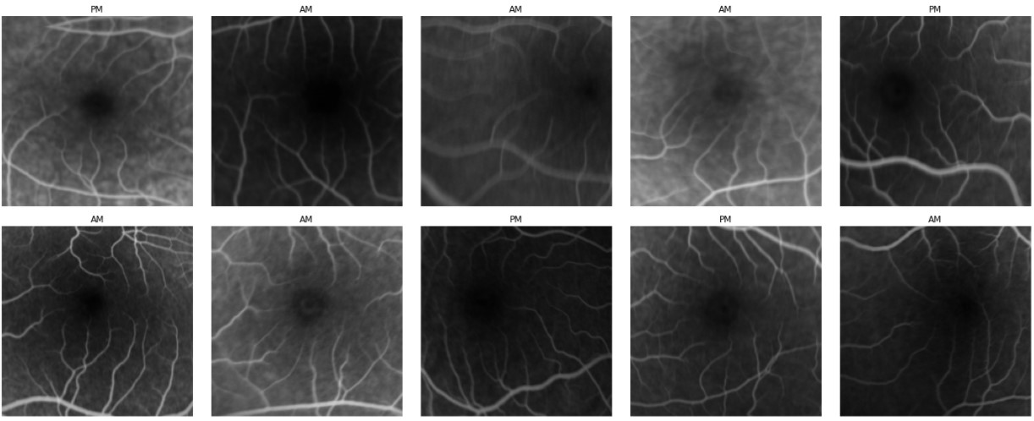

Slide 11
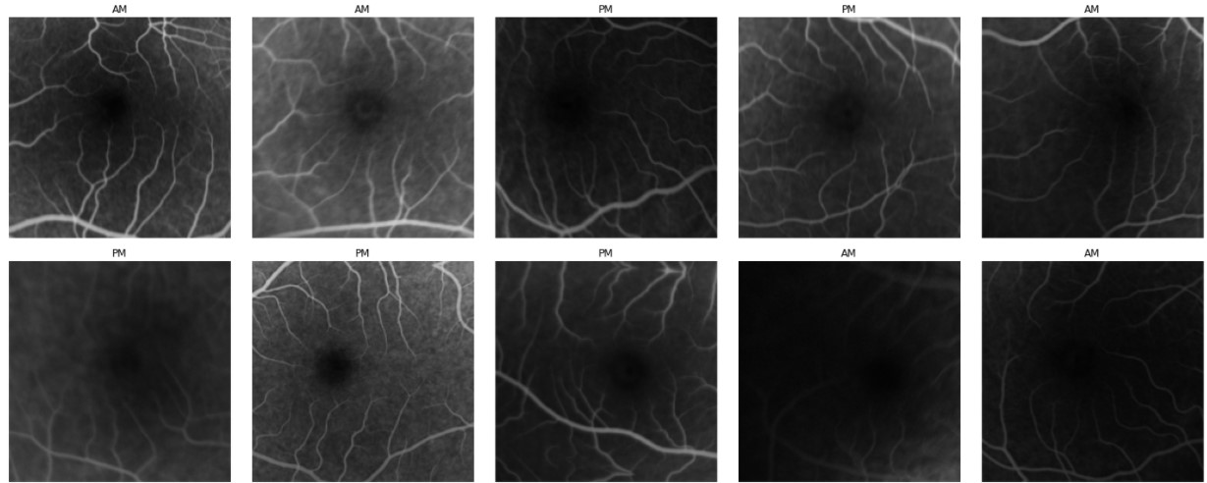

Slide 12
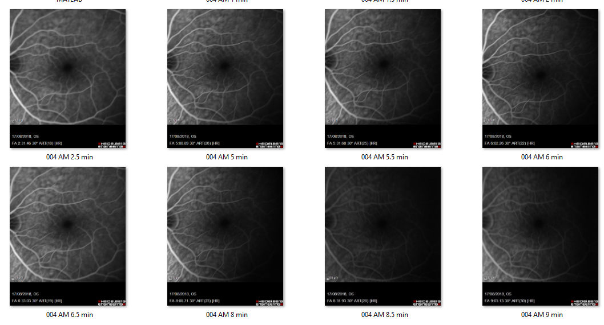

Slide 13
CNN LSTM

Slide 14

LSTM

Slide 15
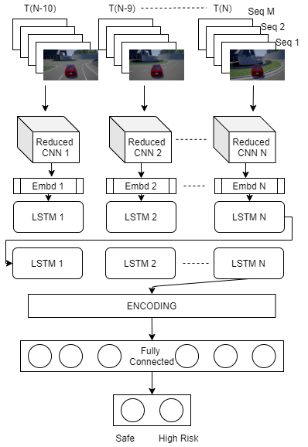
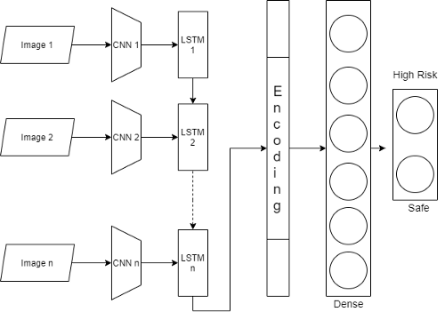
AM
PM
AM PM

Slide 16
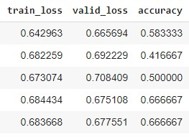
Results from CNN LSTM
Accuracy
66.67%

Slide 17
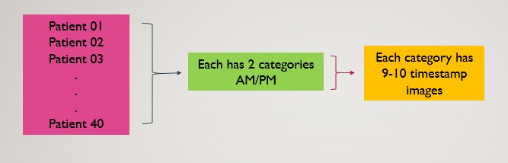
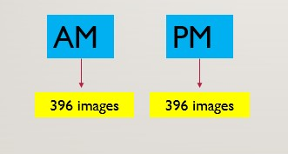
Modified Dataset
Previous approach of dataset
Current approach of dataset

Slide 18
Densenet121

Slide 19
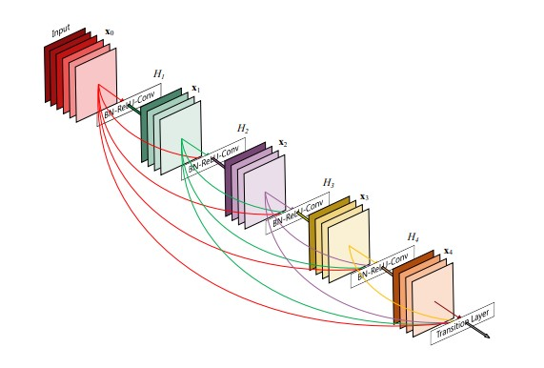
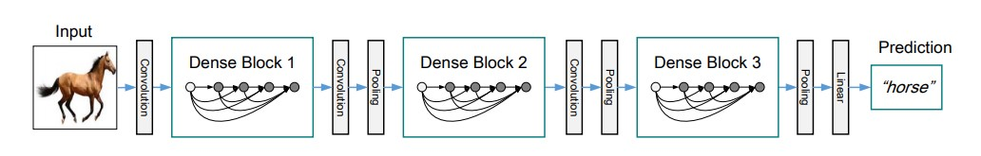
AM

Slide 20
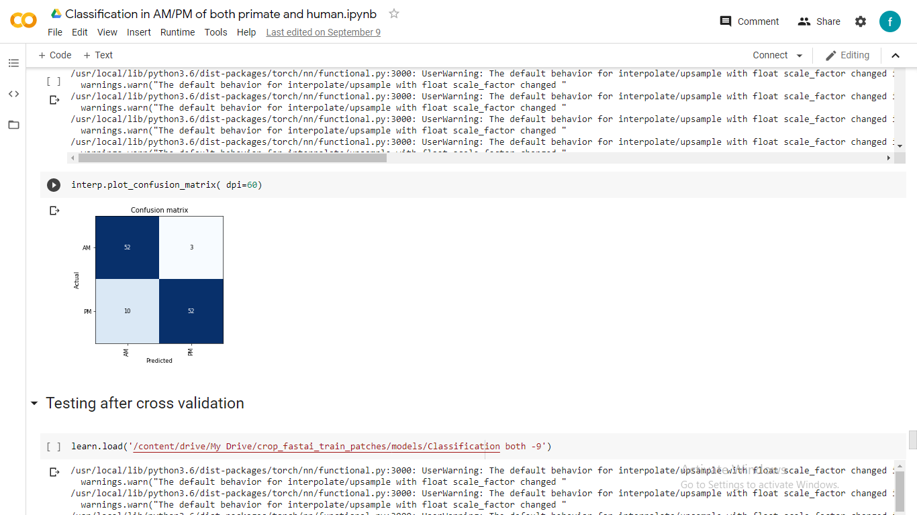
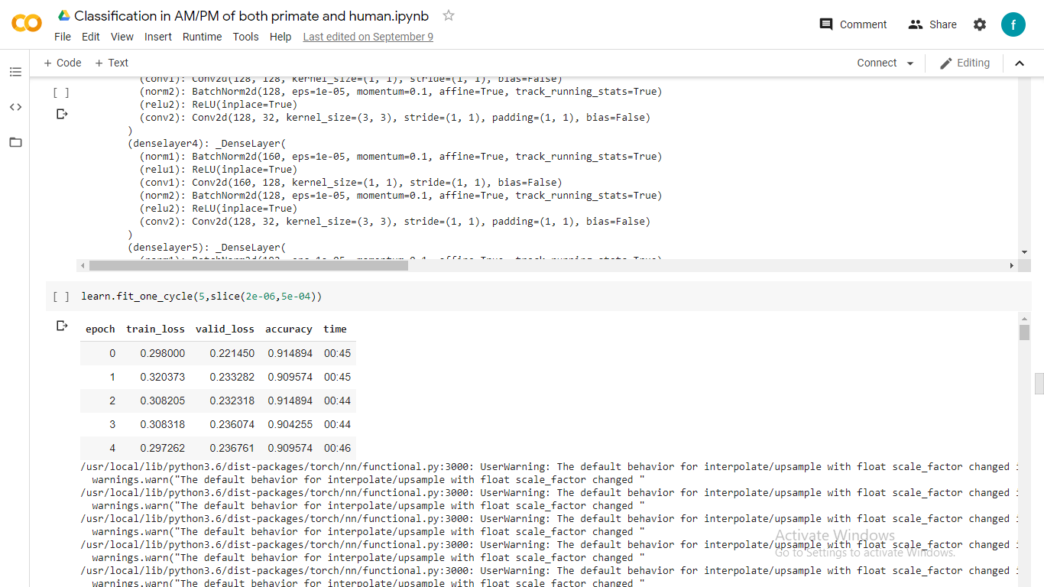
Results from the Densenet121 Model
Accuracy
90.9%

Slide 21
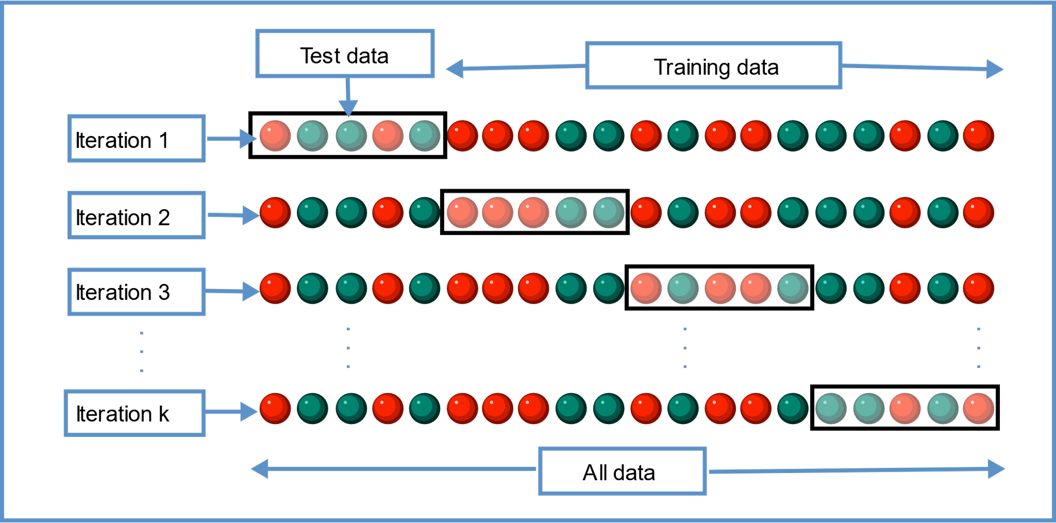
K-Fold Cross Validation
Why we use?
Cross-validation is a resampling procedure used to evaluate machine learning models on a limited data sample.

Slide 22
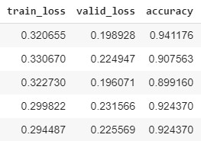
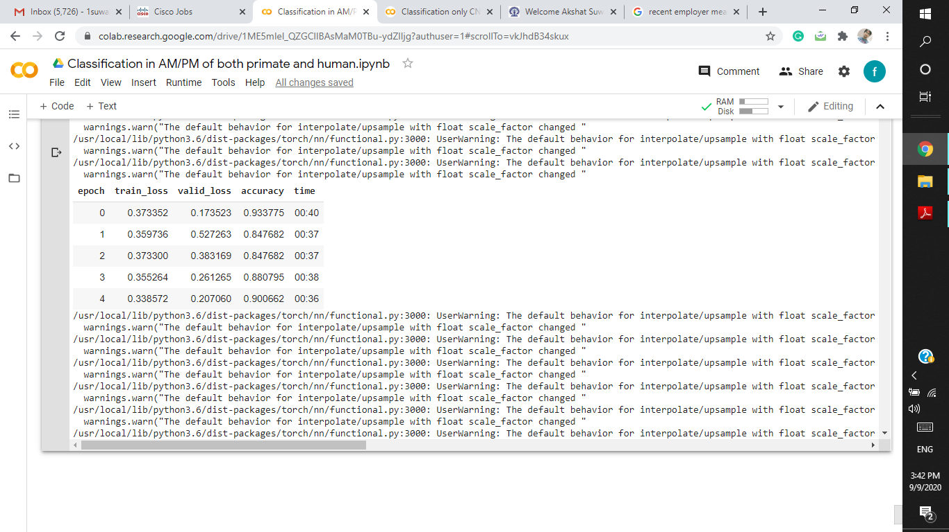
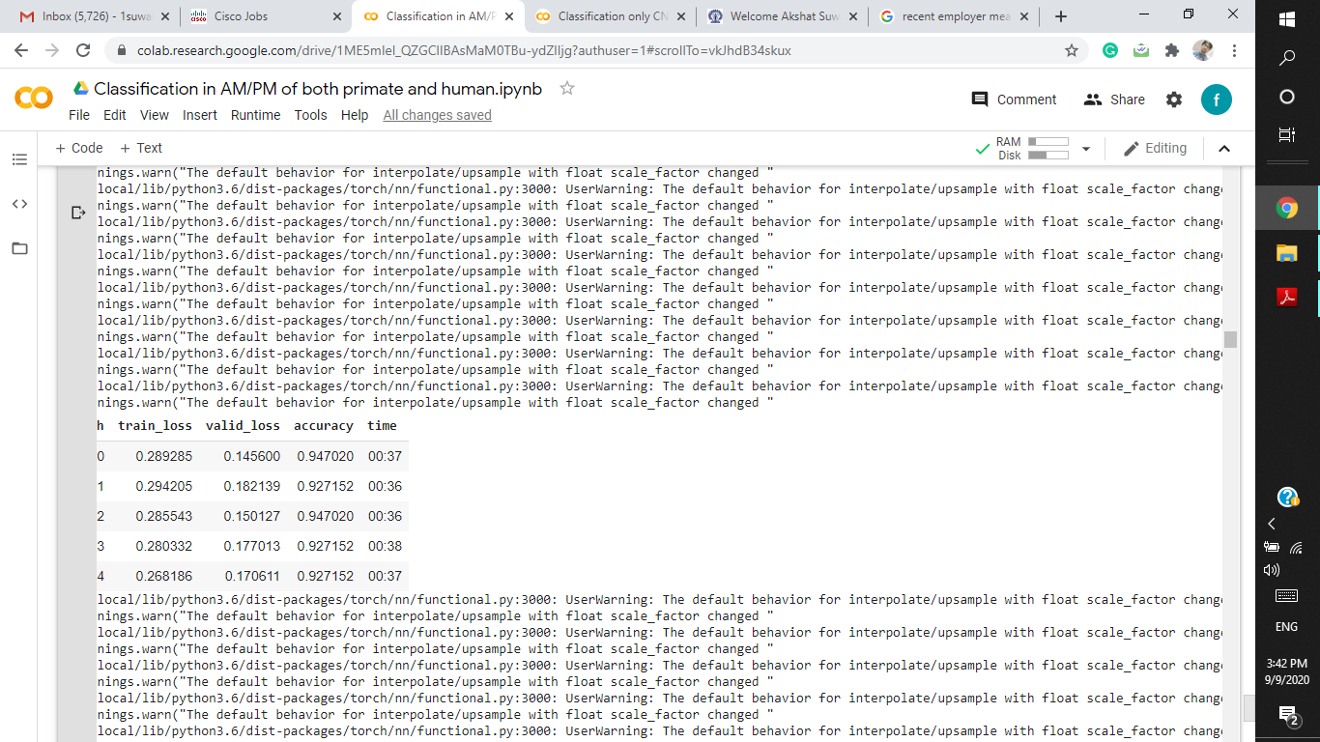
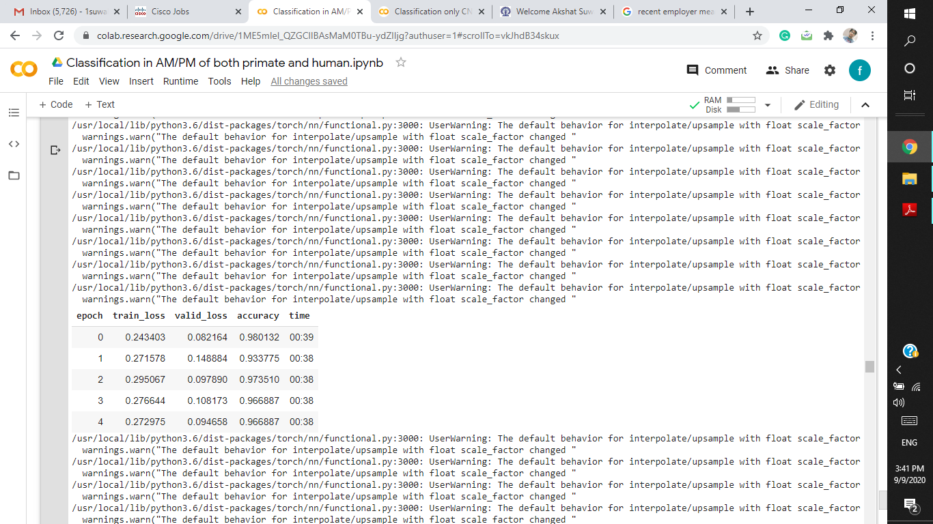
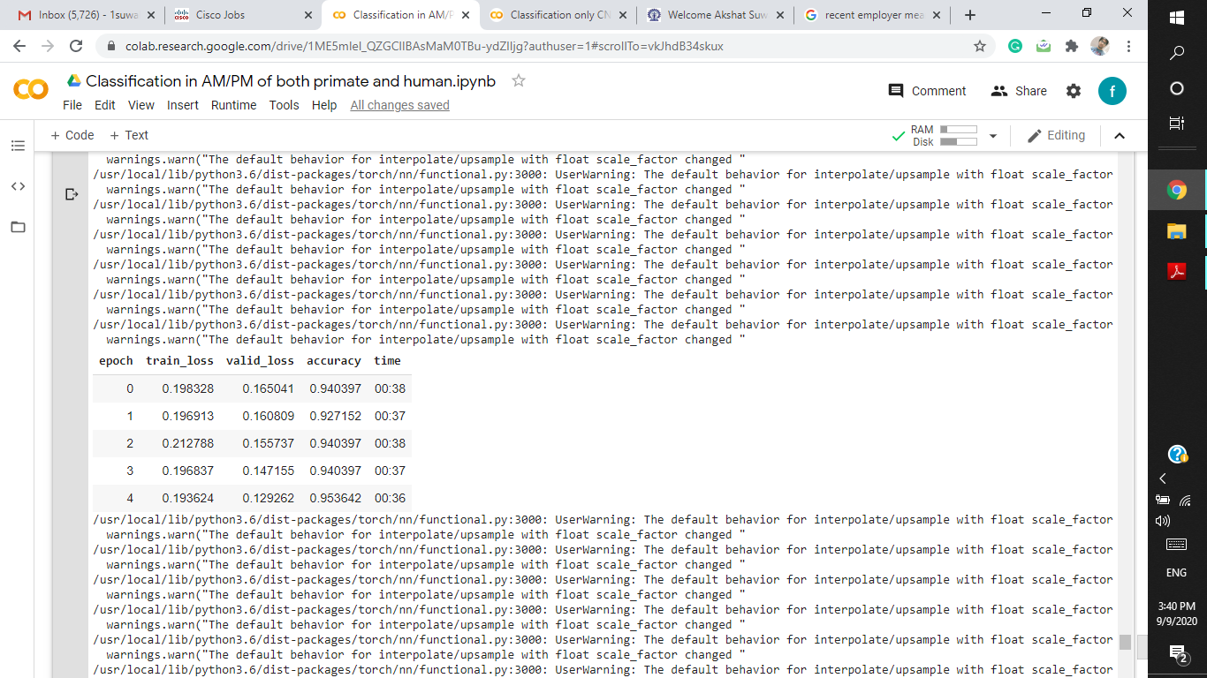
5-fold Cross Validation
Fold = 1
Fold = 2
Fold = 3
Accuracy
Accuracy
Accuracy
92.4%
90.0%
92.7%
Fold = 4
Fold = 5
Accuracy
Accuracy
96.6%
95.7%

Slide 23
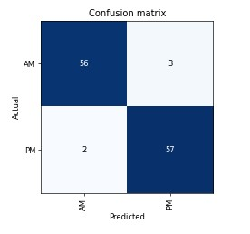
Confusion Matrix of one of the Fold in the Cross Validation
Accuracy
95.7%

Slide 24
Links of my code
Code in Fastai of CNN LSTM
https://colab.research.google.com/drive/1Apx274ciDIXn-gDGNVTxLdnb-qPCcjMy?usp=sharing
Code in Tensorflow of CNN LSTM
https://colab.research.google.com/drive/1RNQ9mow1cilDkfWTCOcYXeM8xQU1mcH2?usp=sharing
Code in Fastai of Densenet121
https://colab.research.google.com/drive/1ME5mlel_QZGClIBAsMaM0TBu-ydZIljg?usp=sharing

